Slide 1
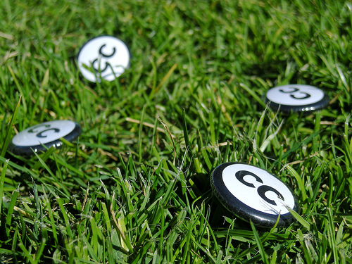



Controlling (copyright) Anarchy
Jessica Coates
Creative Commons Clinic
May 2008
Carpeted commons by Glutnix, http://www.flickr.com/photos/glutnix/2079709803/in/pool-ccswagcontest07 available under a Creative Commons Attribution 2.0 licence, http://creativecommons.org/licenses/by/2.0/deed.en
AUSTRALIA
part of the Creative Commons international initiative
CRICOS No. 00213J

Slide 2
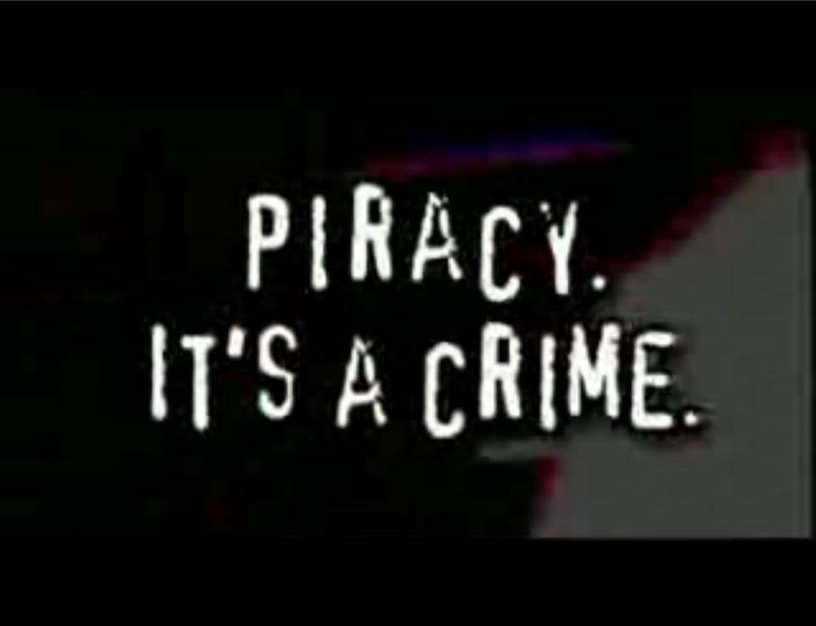

AUSTRALIA
part of the Creative Commons international initiative
CRICOS No. 00213J
Notes:
Standard copyright law says that you can’t reproduce or communicate creative material (eg movies, books, music etc) without the copyright owner’s permission, except in very limited circumstances
The problem with this in the digital era is that every use of material makes a reproduction. This includes just viewing
This means that, under the default copyright laws, printing out a webpage, emailing a picture to your friend, making a digital collage or remix work etc will all generally infringe copyright

Slide 3


Why have copyright?
by granting creators commercial publication rights you ensure that they will be remunerated, which gives incentive for them to create
traditionally, all reproductions = commercial publication
therefore, copyright prohibits all unauthorised reproductions
AUSTRALIA
part of the Creative Commons international initiative
CRICOS No. 00213J
Notes:
Standard copyright law says that you can’t reproduce or communicate creative material (eg movies, books, music etc) without the copyright owner’s permission, except in very limited circumstances
The problem with this in the digital era is that every use of material makes a reproduction. This includes just viewing
This means that, under the default copyright laws, printing out a webpage, emailing a picture to your friend, making a digital collage or remix work etc will all generally infringe copyright

Slide 4
Default copyright
Copyright is important. But in its current form it:
doesn’t reflect the behaviour of ordinary users
doesn’t reflect the wishes of many creators
makes it difficult to promote, collaborate or remix
prevents digital technologies from being used to their fullest
AUSTRALIA
part of the Creative Commons international initiative
CRICOS No. 00213J

Slide 5
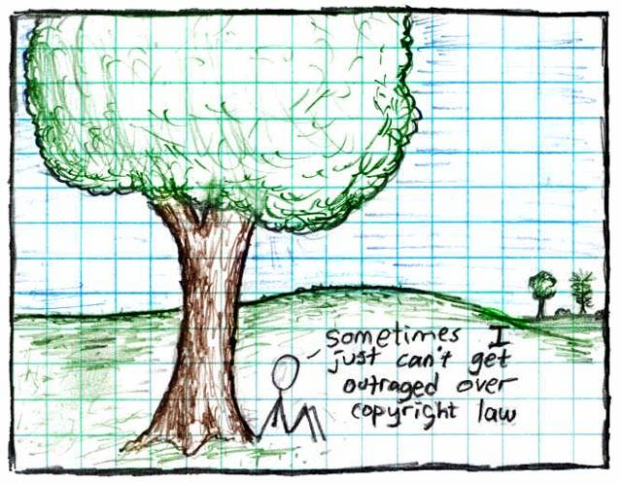
"Copyright", Randall Munroe, http://xkcd.org/14/, Creative Commons Attribution-NonCommercial 2.5 license
AUSTRALIA
part of the Creative Commons international initiative
CRICOS No. 00213J
Notes:
Some just say ignore copyright law – rip, mix, burn
This is ok if you’re an private user, or an obscure artist – can choose to take risk
But doesn’t work for schools, libraries, museums, charities, academics, short film makers entering into competitions, DJs releasing a commercial CD etc
Plus, the music labels and hollywood are suing people now – and in the UK they’re threatening to cut off people’s internet connections.

Slide 6

Aims to make creative material more useable by providing free licences that creators can use to give certain permissions in advance
AUSTRALIA
part of the Creative Commons international initiative
CRICOS No. 00213J
Notes:
Non-profit
Founded in 2001
These academics became concerned that the default copyright laws that applied in most countries were restricting creativity in the digital environment by preventing people from being able to access, remix and distribute copyright material online
Taking inspiration from the open source movement, they decided to develop a set of licences that creators could use to make their material more freely available without giving up their copyright
They wanted to replace the standard “all rights reserved” model with a new, more flexible, “some rights reserved”

Slide 7

CC is designed to…
provide standardised licences
that facilitate sharing
are flexible
are easy to use and understand (for people and machines) and
that apply in the same way anywhere in the world.
AUSTRALIA
part of the Creative Commons international initiative
CRICOS No. 00213J
Notes:
In writing the licences, the main goal was to ensure that the licences are:
Voluntary – contrary to some claims, CC isn’t anti-copyright. It just aims to provide options for those copyright owners who do want to make their material more freely available
Flexible – unlike other parts of the open access movement, CC licences are specifically designed to provide a range of options for licensors, so that they can choose exactly how they want their material to be used
Easy to understand – the academics designing the licences felt that one of the biggest problems with default copyright law is that its so hard for both copyright owners and users to understand. So the licences are specifically designed to be as simple as possible.
And, of course, freely available for everyone to use

Slide 8
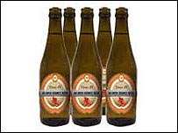
CC Myths
CC is not:
Anti-copyright – just another rights management tool for creators
The public domain – just giving certain permission in advance
Anti-commercial – can charge for first use, commercial uses, “premium” service, or embed advertising
Right for every situation – entirely voluntary, and won’t be best solution for all creators
free as in speech,
not as in beer
AUSTRALIA
part of the Creative Commons international initiative
CRICOS No. 00213J
Notes:
Non-profit
Founded in 2001
These academics became concerned that the default copyright laws that applied in most countries were restricting creativity in the digital environment by preventing people from being able to access, remix and distribute copyright material online
For instances – most people know that it’s currently illegal under Australian law to record a television show to watch later – but did you also know that, in the absence of any licence, it’s also arguably illegal to print off a webpage for personal use, or to use a song in the background of a home video, or a student film
Even those people who want to make their material more freely available can’t do so without hiring lawyers
Taking inspiration from the open source movement, they decided to develop a set of licences that creators could use to make their material more freely available without giving up their copyright
They wanted to replace the standard “all rights reserved” model with a new, more flexible, “some rights reserved”

Slide 9
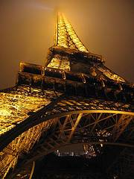
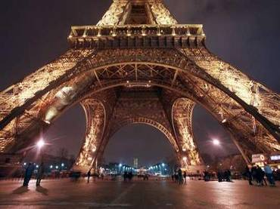
How does it work?
www.smh.com.au
Eiffel Tower at night by rednuht,
http://www.flickr.com/photos/rednuht/275062341/,
Creative Commons Attribution 2.0
http://creativecommons.org/licenses/by/2.0/deed.en
AUSTRALIA
part of the Creative Commons international initiative
CRICOS No. 00213J

Slide 10
Attribution
Attribution-ShareAlike
Attribution-Noncommercial
Attribution-Noncommercial-ShareAlike
Attribution-NoDerivatives
Attribution-Noncommercial-NoDerivatives
AUSTRALIA
part of the Creative Commons international initiative
CRICOS No. 00213J
Notes:
Users can mix and match these elements to set the conditions of use for their material
So, for example, an author may be happy to allow private uses of their work, but may want to limit how it can be used commercially.
They may also want people to remix their work, but only so long as that person attributes them and makes the new work available for others to remix
So they can choose the Attribution-noncommercial-sharealike licence

Slide 11
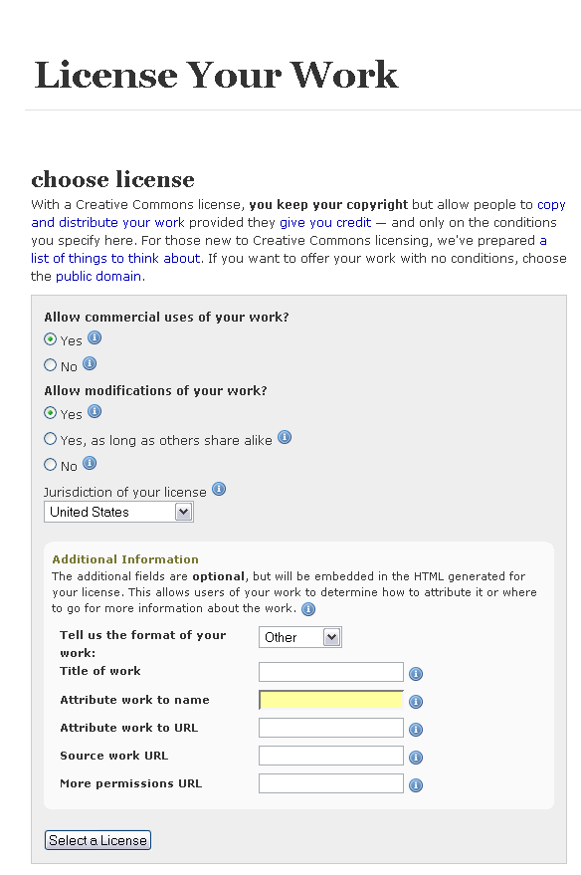
CC system
licence generator
AUSTRALIA
part of the Creative Commons international initiative
CRICOS No. 00213J
Notes:
CC also has a number of tailored licences, for example:
the Sampling Licences – allow portions of a work, but not the whole, to be remixed into new works, even commercially;
the Public Domain Dedication – lets creators revoke their copyright rights entirely, and donate their work to the public domain;

Slide 12
CC system
licence button
AUSTRALIA
part of the Creative Commons international initiative
CRICOS No. 00213J
Notes:
CC also has a number of tailored licences, for example:
the Sampling Licences – allow portions of a work, but not the whole, to be remixed into new works, even commercially;
the Public Domain Dedication – lets creators revoke their copyright rights entirely, and donate their work to the public domain;

Slide 13
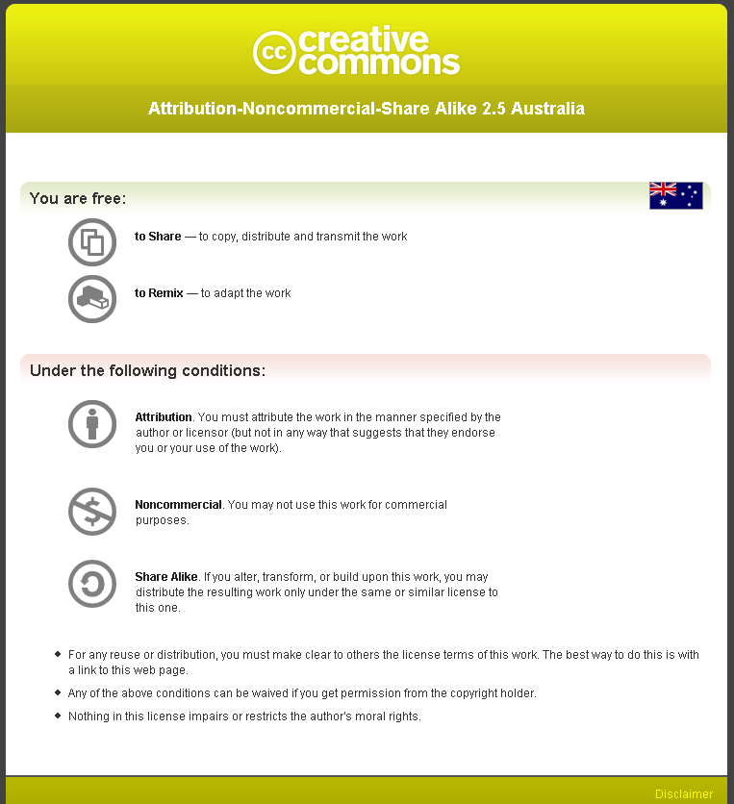
CC system
licence deed
AUSTRALIA
part of the Creative Commons international initiative
CRICOS No. 00213J
Notes:
CC also has a number of tailored licences, for example:
the Sampling Licences – allow portions of a work, but not the whole, to be remixed into new works, even commercially;
the Public Domain Dedication – lets creators revoke their copyright rights entirely, and donate their work to the public domain;

Slide 14
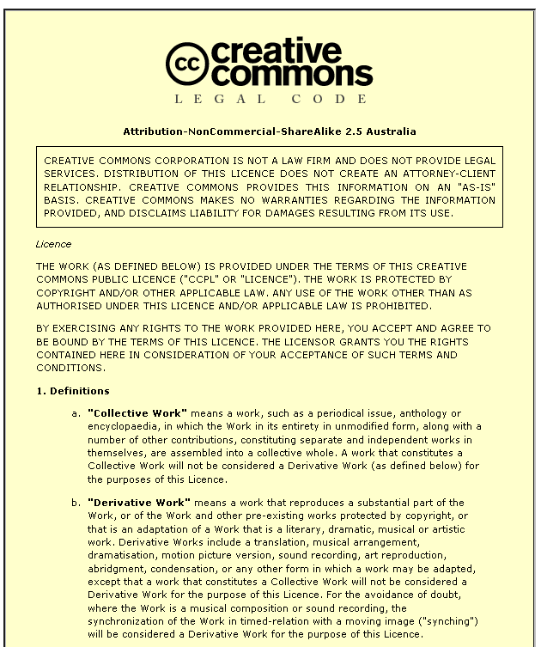
CC system
legal code
AUSTRALIA
part of the Creative Commons international initiative
CRICOS No. 00213J
Notes:
CC also has a number of tailored licences, for example:
the Sampling Licences – allow portions of a work, but not the whole, to be remixed into new works, even commercially;
the Public Domain Dedication – lets creators revoke their copyright rights entirely, and donate their work to the public domain;

Slide 15
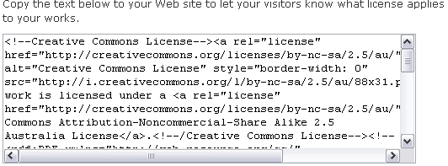
CC system
metadata
AUSTRALIA
part of the Creative Commons international initiative
CRICOS No. 00213J
Notes:
CC also has a number of tailored licences, for example:
the Sampling Licences – allow portions of a work, but not the whole, to be remixed into new works, even commercially;
the Public Domain Dedication – lets creators revoke their copyright rights entirely, and donate their work to the public domain;

Slide 16










Finding CC material
AUSTRALIA
part of the Creative Commons international initiative
CRICOS No. 00213J

Slide 17
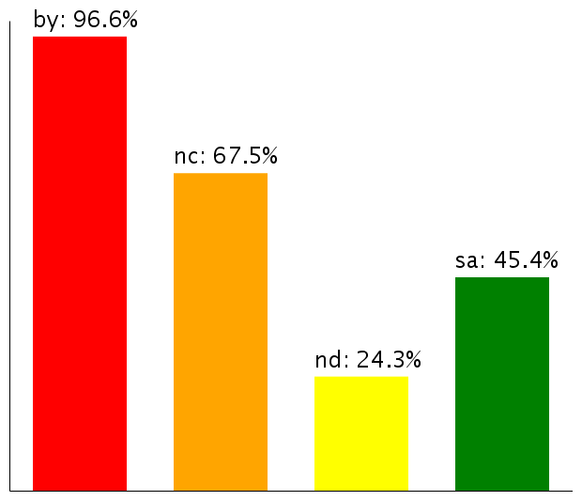
Licence Use
Mid-2006 about 140 million
Now – over 60 million on Flickr alone
Most have Noncommercial limitation
Moving towards more liberal licences
Use of licence elements – June 2006
AUSTRALIA
part of the Creative Commons international initiative
CRICOS No. 00213J
Notes:
So – looking at how the CC licences are being used
According to the latest statistics from the CC website, there are currently about 140million webpages that use a CC licence
As you can see, almost all of them contain the BY element – that’s because it was made compulsory for all the licences except the public domain licences after the first year, because pretty much everybody was using it anyway
The majority also, unsurprisingly, choose the non-commercial element
Interestingly, next most popular is ShareAlike, not noderivatives – this shows that there is still a strong focus on fostering creativity among CC community, and that, rather than trying to lock their material up, people are happy for it to be remixed, as long as the new work is also sharedEven more interesting is how these statistics are changing over time
Even more interestingly – if you look at how the licences is being used over time, people are gradually moving towards more liberal licences with less restrictions on them
This movement seems to indicate that as people become more familiar with the licences, they are more comfortable allowing greater use
This is supported by anecdotal evidence from CC users who, after initially publishing their material under restrictive licences that don’t allow derivatives, often ‘re-release’ their material to allow new works

Slide 18




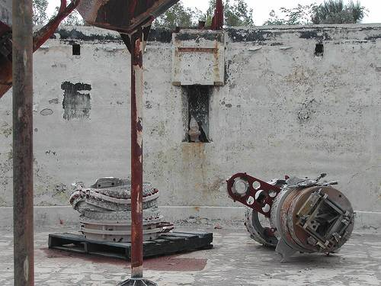
CC as a resource
Simplify copyright decisions
Clarify legal rights and responsibility
Reduce costs
Streamline processes
Access new/innovative material
AUSTRALIA
part of the Creative Commons international initiative
CRICOS No. 00213J
Notes:
In writing the licences, the main goal was to ensure that the licences are:
Voluntary – contrary to some claims, CC isn’t anti-copyright. It just aims to provide options for those copyright owners who do want to make their material more freely available
Flexible – unlike other parts of the open access movement, CC licences are specifically designed to provide a range of options for licensors, so that they can choose exactly how they want their material to be used
Easy to understand – the academics designing the licences felt that one of the biggest problems with default copyright law is that its so hard for both copyright owners and users to understand. So the licences are specifically designed to be as simple as possible.
And, of course, freely available for everyone to use

Slide 19

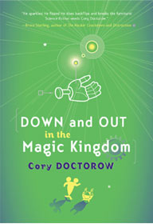
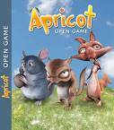



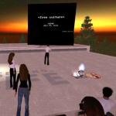
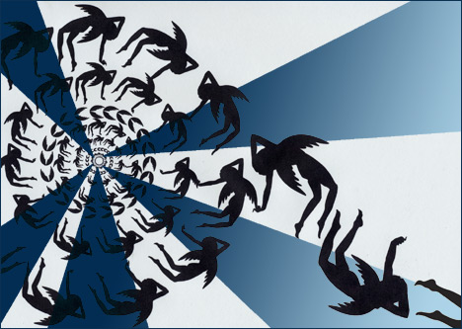

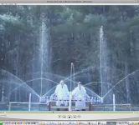

As a licensing tool
Facilitate sharing
Community engagement
Increase reach and reputation
Internal rights management
Access new business models
Encourage collaboration and innovation
AUSTRALIA
part of the Creative Commons international initiative
CRICOS No. 00213J
Notes:
In writing the licences, the main goal was to ensure that the licences are:
Voluntary – contrary to some claims, CC isn’t anti-copyright. It just aims to provide options for those copyright owners who do want to make their material more freely available
Flexible – unlike other parts of the open access movement, CC licences are specifically designed to provide a range of options for licensors, so that they can choose exactly how they want their material to be used
Easy to understand – the academics designing the licences felt that one of the biggest problems with default copyright law is that its so hard for both copyright owners and users to understand. So the licences are specifically designed to be as simple as possible.
And, of course, freely available for everyone to use

Slide 20


CC projects
CC+
+
AUSTRALIA
part of the Creative Commons international initiative
CRICOS No. 00213J
Notes:
Another interesting “second generation” CC user is Revver
Revver is a free video sharing site, similar to Youtube
But, unlike Youtube, Revver aims to take advantage of the popularity of sharing videos online to provide a revenue-raising model for video makers
And as part of this business model, it requires that all people upload their material under a CC BY-MC-ND licence
Revver’s still in its early days, but it does already have a success story in the “extreme diet coke and mentos experiment” video
hopefully at least some of you have already seen this online
But just in case you haven’t here it is
By June this year this video has been downloaded more than 6 million times, and earned its makers over US$30,000 in revenue
It’s hosted a number of ads - first for the movie “Kiss Kiss Bang Bang” – and then for mentos.
Strangely, coke wasn’t interested
This has encouraged other popular online videos, such as “ask a ninja”, to put themselves on Revver

Slide 21
Thanks
creativecommons.org
wiki.creativecommons.org/casestudies
creativecommons.org.au
info@creativecommons.org.au
Carpeted commons by Glutnix, http://www.flickr.com/photos/glutnix/2079709803/in/pool-ccswagcontest07 available under a Creative Commons Attribution 2.0 licence, http://creativecommons.org/licenses/by/2.0/deed.en
This slide show is licensed under a Creative Commons Australia Attribution licence. For more information see http://creativecommons.org/licenses/by/2.5/au/.
AUSTRALIA
part of the Creative Commons international initiative
CRICOS No. 00213J

